Slide 1
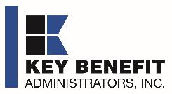
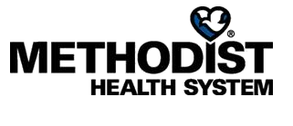
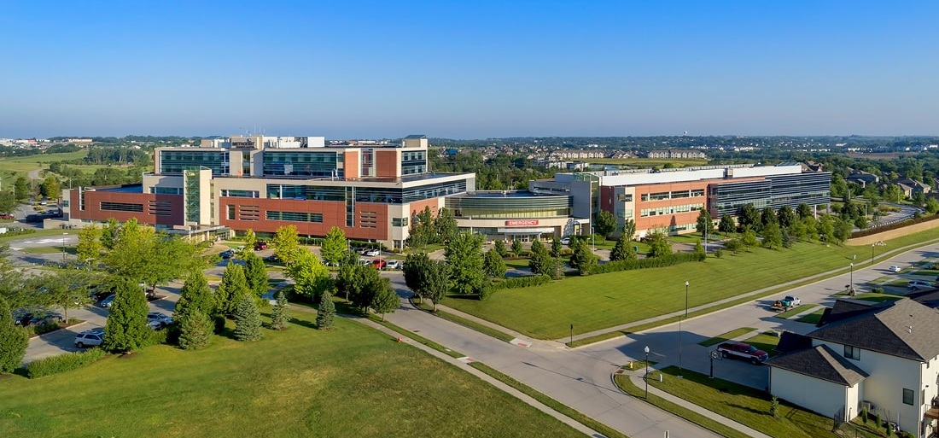
METHODIST HEALTH SYSTEM DIRECT-TO-EMPLOYER PLAN
October 10, 2024

Slide 2



Founded in 1979 and headquartered in Indianapolis, IN​
Full-service TPA specializing in the administration of self-funded health plans and population health management​
One of the country’s largest independently-owned TPAs
The Key Family is a commonly-held group of benefits related organizations with:​
3,000+ corporate clients​
3.0 million members under management​
700 Employees
Exclusive Relationships
We know The Market – Agents, Networks, and MGAs

Slide 3


Market Leader in Private Labeled DTE Plans
Louisville, KY
OneHealth Plan
Cincinnati, OH
TCH Optimal
Bentonville, AR
Northwest Health Plan
Knoxville, TN
East Tennessee Health Plan
Meridian, MS
Affinity Health Plan
Fort Myers, FL
Lee Health Care Partners

Slide 4

Direct-to-Employer (DTE) Your Health Plan Focused on a Direct Relationship with Self-Funded Employers in Your Market
YOU Pick the Name of the Health Plan
YOU Determine the Fees Charged
YOU Practice the Medicine
YOU Receive the Profits
WE Make it Successful

Slide 5
Methodist Health System is Patient Recommended
Based on quality measures and HCAHPS feedback, KBA estimates that Methodist Health System has the strongest brand quality in Methodist Health System’s Competitive Area*.
Health System | HCAHPS Recommendation Percentile | CMS Stars Percentile | Mortality Percentile | Readmission Percentile | KBA Brand Quality Score
Methodist Health System | 84 | 79 | 70 | 70 | 74
Other Independent Hospitals | 62 | 83 | 72 | 75 | 65
Nebraska Medicine | 58 | 65 | 91 | 68 | 65
CommonSpirit Health | 25 | 71 | 64 | 73 | 53
KBA defines Methodist Health System’s competitive area as including Audubon, Cass, Fremont, Harrison, Mills, Montgomery, Pottawattamie, Shelby, Burt, Cuming, Dodge, Douglas, Sarpy, Saunders, and Washington Counties

Slide 6
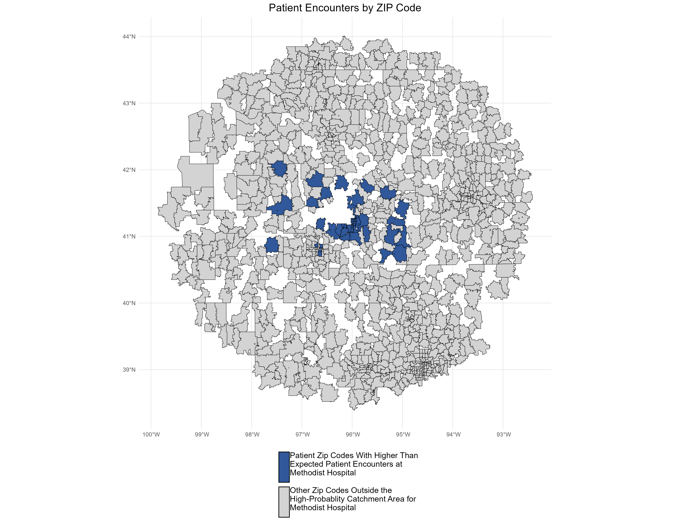
Patients Pass Other Hospitals to Come to Methodist Health System
KBA models Medicare patient encounter data to identify strong health system brands where patients will travel past other hospitals or long distances to frequent a specific hospital.
The center of the donut are zip codes within which patients have a higher probability of frequenting Methodist Hospital. These zip codes are ignored for this analysis.
Significant patient encounters outside of this center, as seen here, indicate that patients are willing to travel significant distances, passing other hospitals to go to Methodist Hospital.

Slide 7

Direct-to-Employer Strategy: Only Available to Premier Health Systems
STRONG Brand Quality
EXTENSIVE Patient Access
AFFORDABLE Value Pricing
EXCELLENT Care Quality

Slide 8
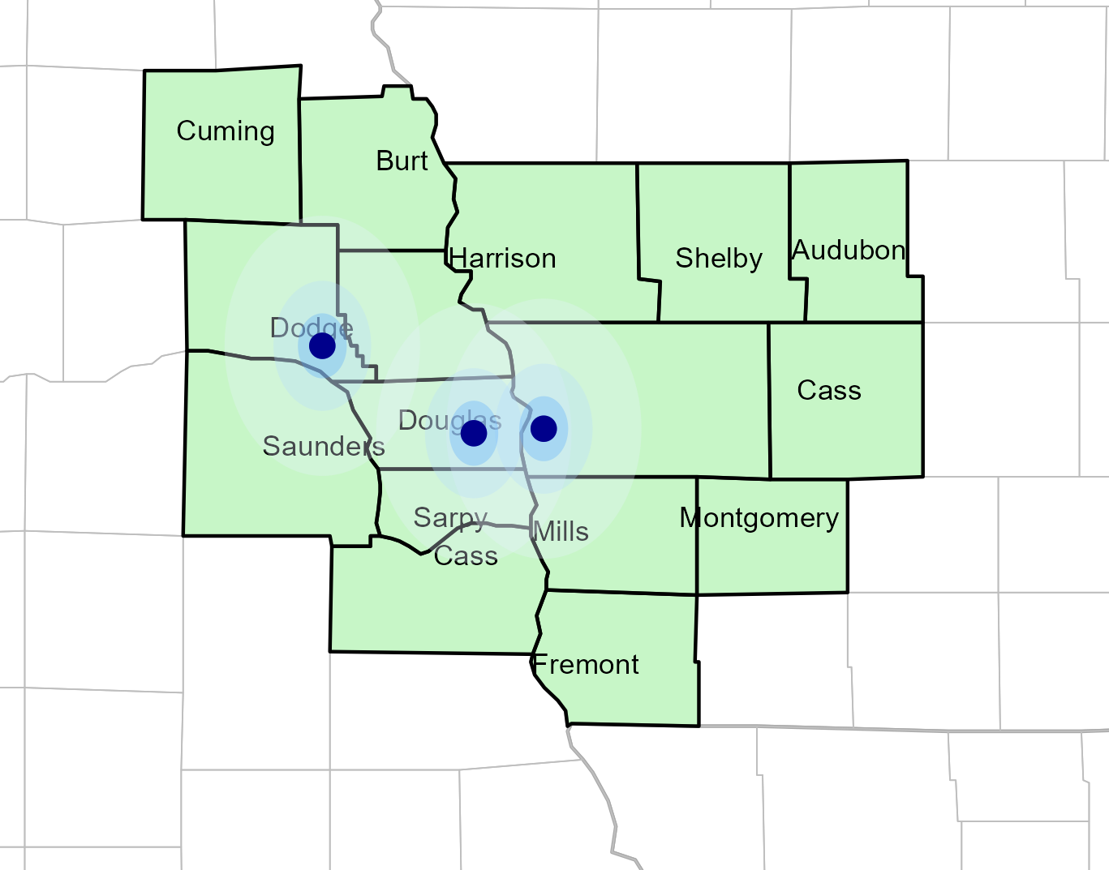
Significant Opportunity for Plan Growth Researched for Eastern Nebraska/Western Iowa
Target Market 1.400+ Employers 300,000+ Employees 600,000+ Members
 | Employer Size Group (# of Employees)
Commercial Employers With Headquarters | 50-100 | 101-200 | 201-400 | 401-1,000 | 1,001-3,000 | 3,000+
In Catchment Area | 769 | 329 | 193 | 136 | 51 | 28
Total Employees at Employers | 50-100 | 101-200 | 201-400 | 401-1,000 | 1,001-3,000 | 3,000+
Headquartered in Catchment Area | 57,675 | 49,350 | 57,900 | 95,200 | 102,000 | 308,000
Total Members with Employers | 50-100 | 101-200 | 201-400 | 401-1,000 | 1,001-3,000 | 3,000+
Headquartered in Catchment Area | 103,815 | 88,830 | 104,220 | 171,360 | 183,600 | 554,400

Slide 9
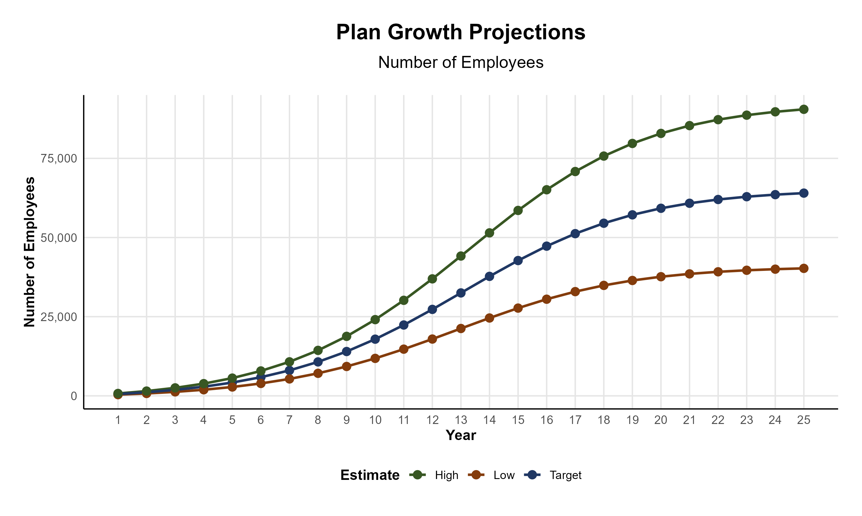
Plan Potential Growth Paths
Self Funded
283K
PLAN GROWTH POTENTIAL
465K
Insured
Working Age
620K
Population
1,075K
Estimates include Audubon, Cass, Fremont, Harrison, Mills, Montgomery, Pottawattamie, Shelby, Burt, Cuming, Dodge, Douglas, Sarpy, Saunders, and Washington Counties

Slide 10

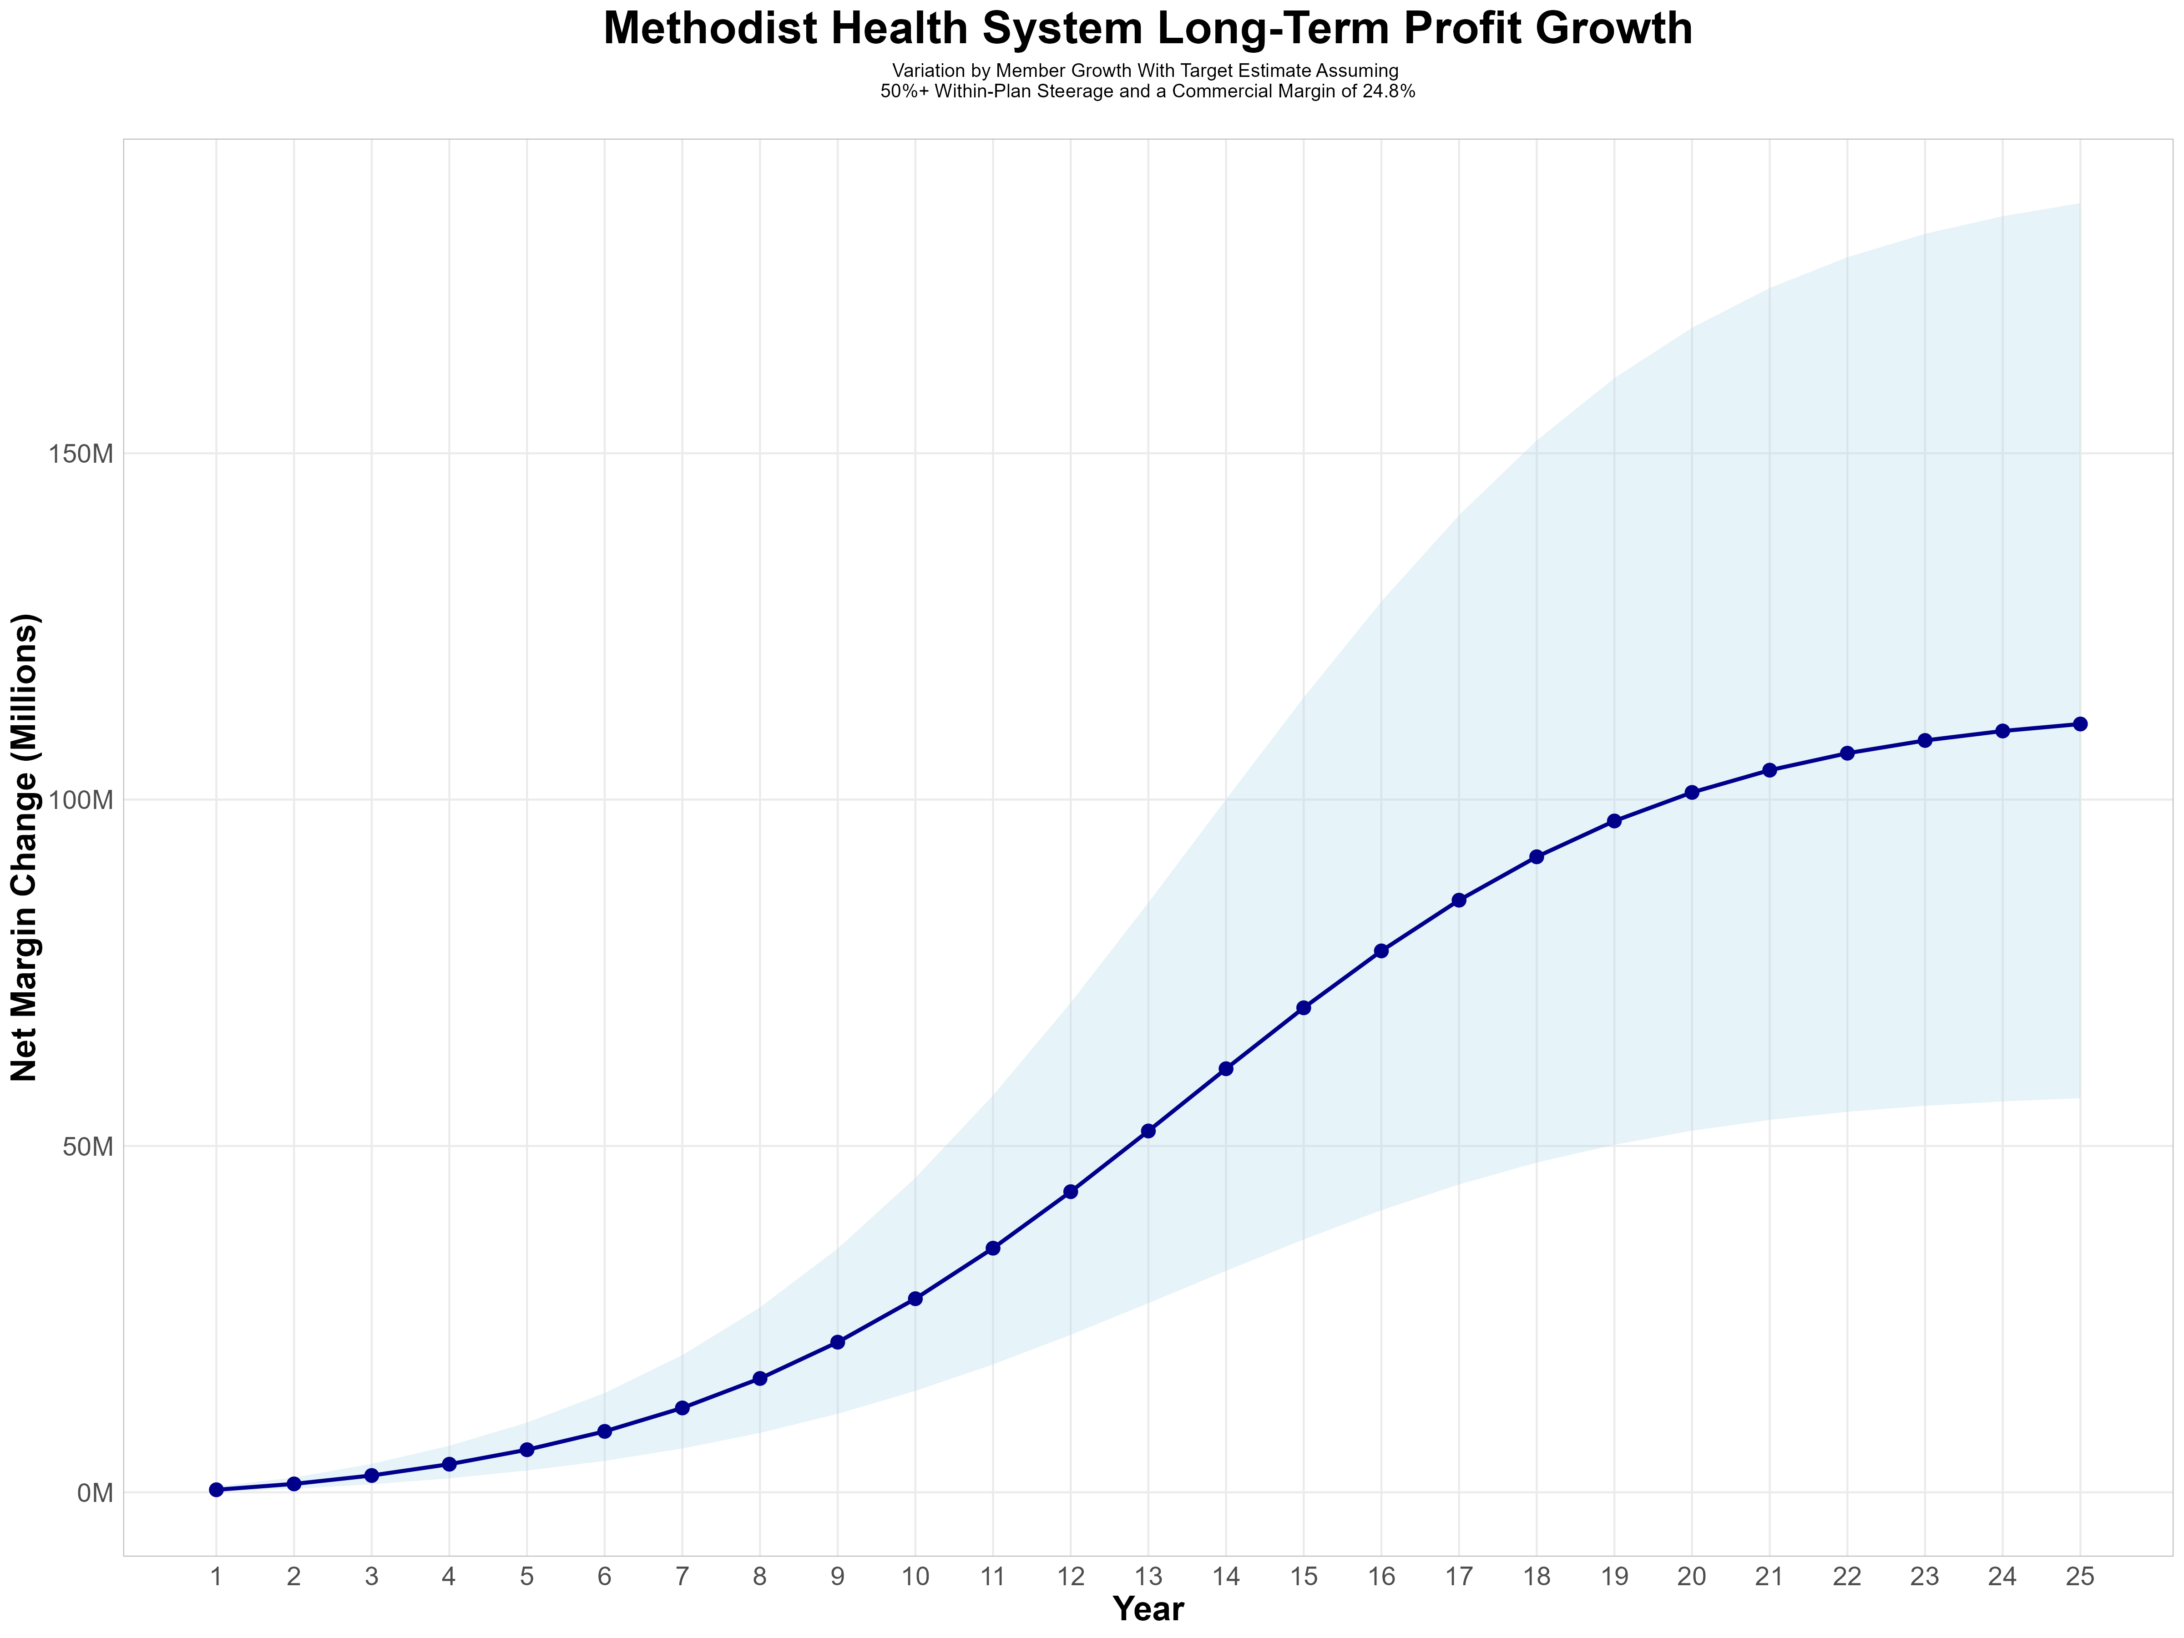
Growing Powerful, Lasting Profitability
Early Stage
Gaining Name Recognition, Early Growth
New Revenue:
New Profit:
$24.79M
$6.45M
Growth Stage
Strong Reputation, Strong Growth
New Revenue:
New Profit:
$182.44M
$48.71M
Mature Stage
High Profitability, Market Saturation
New Revenue:
New Profit:
$380.58M
$101.72M

Slide 11
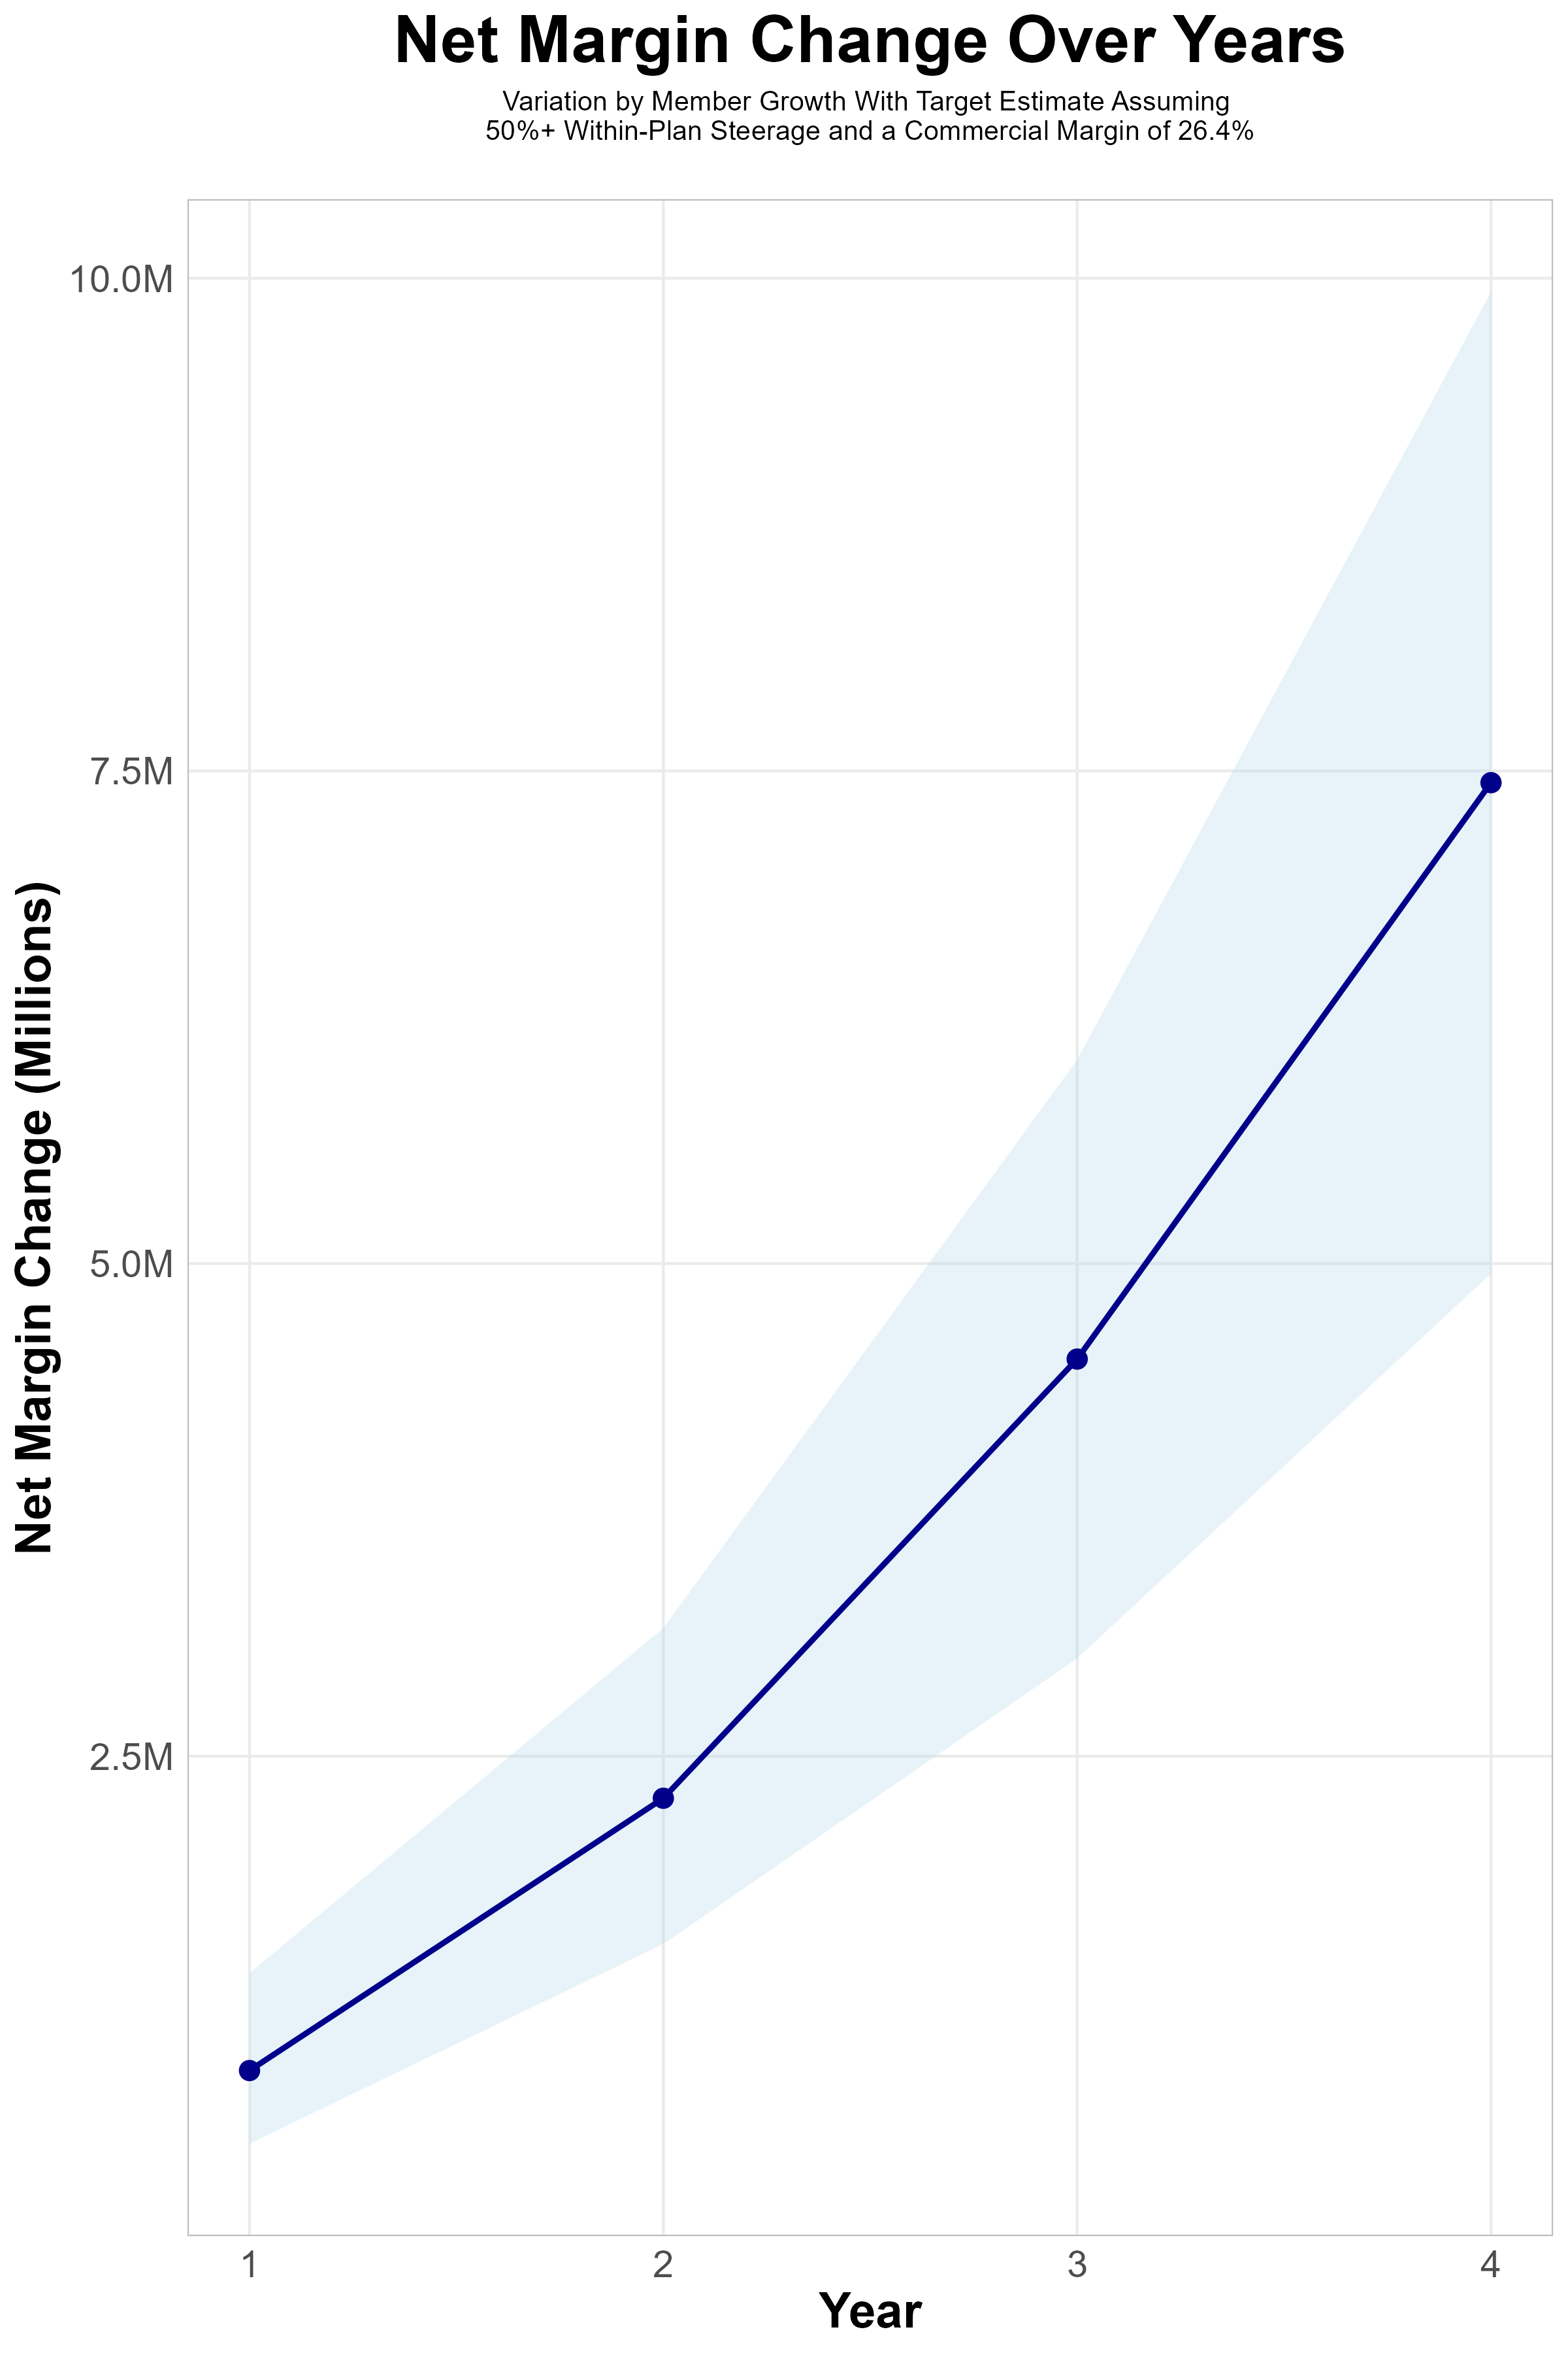
FOUR-YEAR PROJECTIONS
Target Member Growth | Target Member Growth | Target Member Growth | Target Member Growth | Target Member Growth
Metric | Year 1 | Year 2 | Year 3 | Year 4
Number of Members | 1,000 | 2,000 | 3,400 | 5,200
Incremental Margin | 1,222.8K | 2,442.6K | 4,654.4K | 7,558.0K
Network Access Fee | 12.0K | 24.0K | 40.8K | 62.4K
Implementation Fee (One-Time) | -150.0K | 0.0K | 0.0K | 0.0K
Sales and Marketing Costs | -180.0K | -180.0K | -180.0K | -180.0K
Net Margin Change | 904.8K | 2,286.6K | 4,515.2K | 7,440.4K
High Member Growth | High Member Growth | High Member Growth | High Member Growth | High Member Growth
Metric | Year 1 | Year 2 | Year 3 | Year 4
Number of Members | 1,400 | 2,700 | 4,500 | 6,900
Incremental Margin | 1,711.9K | 3,297.6K | 6,160.3K | 10,028.8K
Network Access Fee | 16.8K | 32.4K | 54.0K | 82.8K
Implementation Fee (One-Time) | -150.0K | 0.0K | 0.0K | 0.0K
Sales and Marketing Costs | -180.0K | -180.0K | -180.0K | -180.0K
Net Margin Change | 1,398.7K | 3,150.0K | 6,034.3K | 9,931.6K
Low Member Growth | Low Member Growth | Low Member Growth | Low Member Growth | Low Member Growth
Metric | Year 1 | Year 2 | Year 3 | Year 4
Number of Members | 700 | 1,400 | 2,300 | 3,500
Incremental Margin | 855.9K | 1,709.8K | 3,148.6K | 5,087.1K
Network Access Fee | 8.4K | 16.8K | 27.6K | 42.0K
Implementation Fee (One-Time) | -150.0K | 0.0K | 0.0K | 0.0K
Sales and Marketing Costs | -180.0K | -180.0K | -180.0K | -180.0K
Net Margin Change | 534.3K | 1,546.6K | 2,996.2K | 4,949.1K

Slide 12
Year 4 Projected Revenue and Profit
Pre-DTE Cohort of 5,200 Employees | Inpatient | Outpatient | Professional | Total
Revenue† | $ 2,944,793 | $ 3,677,720 | $ 1,717,464 | $ 8,339,978
Net Income‡ | $ 777,425.5 | $ 970,918.1 | $ 453,410.5 | $ 2,201,754
† Assuming proportional revenues from market shares of 18% (inpatient) and 12% (outpatient)
‡ Conservatively assuming a commercial margin of 26.4% (80% of the estimated commercial margin)
With DTE | Inpatient | Outpatient | Professional | Total
Revenue⁰ | $ 11,133,674 | $ 17,449,724 | $ 8,148,873 | $ 36,732,271
Net Income* | $ 2,939,290 | $ 4,606,727 | $ 2,151,302 | $ 9,697,319
⁰ Assuming 67% inpatient and 58% market steerage based on KBA narrow network DTE experience (see extended analysis for more details)
* Conservatively assuming a commercial margin of 26.4%, with a 10 percentage-point reduction to reflect competitive-edge rates and a 10 percentage-point increase due to lower billing costs and higher patient responsibility collections because of the member credit card.
Total Increase in Net Income | $ 7,495,565
Network Access Fee (Revenue) of $1 PMPM | $ 62,400
Total Profit Growth | $ 7,500,365
Minus Implementation Fee (One-Time) | -$ 0
Minus Sales and Marketing (Annual – Ongoing) | -$ 180,000
Total | $ 7,377,965

Slide 13

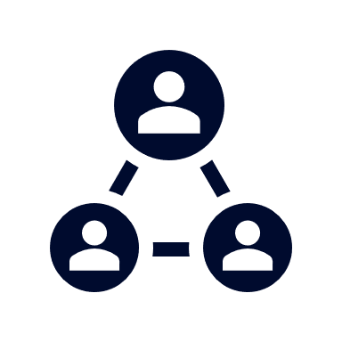



A Partner You Can Trust
OUR OBJECTIVES ARE ALIGNED
WE KNOW THE
MARKET
COMPLETELY TRANSPARENT
WE HAVE THE SOPHISTICATION AND INFRASTRUCTURE TO EFFECTIVELY COMPETE
Derek Moore, Senior Vice President – KBA
845-283-9973 * derek.moore@keybenefit.com

